Slide 1

Department of Computer Science and Engineering, BRAC University
Lecture 9
Sequential Circuit Analysis
Circuit Diagram to State Diagram
State Diagram to Circuit Diagram
Counters
Application of Counters
CSE260 : Digital Logic Design

Slide 2
What is Sequential Logic ?
Sequential circuit has additional dimension which is time
Combinational logic only depends on current input
Sequential circuit output depends on previous input other than current input
More powerful than combination logic
Able to model condition which can’t be modeled by combinational logic
‹#›
Department of Computer Science and Engineering
CSE260 - Digital Logic Design

Slide 3
Circuit Diagram to State Diagram
‹#›
Department of Computer Science and Engineering
CSE260 - Digital Logic Design

Slide 4
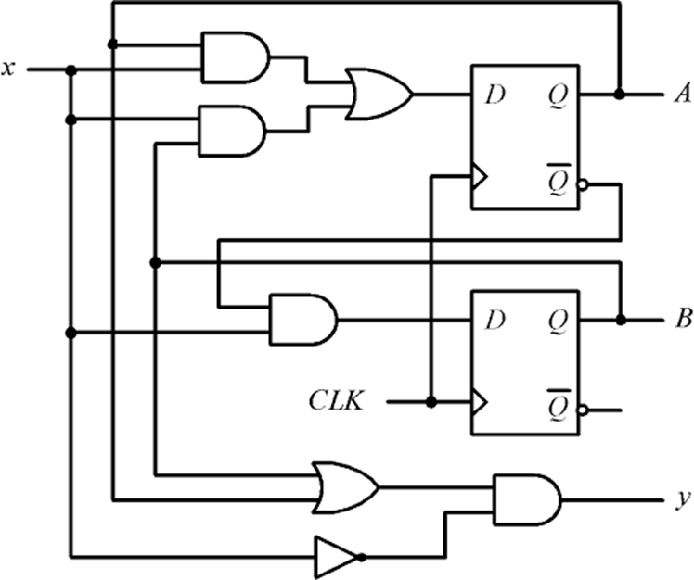

Example 1: Draw the state diagram for the given circuit
Sequential Circuit using D Flip Flop
Present States: A and B
Next States: A+ and B+
Input: DA, DB, x
Output: y
‹#›
Department of Computer Science and Engineering
CSE260 - Digital Logic Design

Slide 5
Sequential Circuit to State Diagram Design Workflow
Steps: |  | Description:
1 | Identify Flip-Flop Type and Equations | Extract the input equations of the Flip-Flops and external output(s) from the given circuit.
2 | Build State Table | Construct the state table using the Flip-Flop Input and output equations found in step-1.
 |  | The state table should contain the following: Present States, external input(s), FF input and outputs.
3 | Determine Next States | Compute the next states from the FF inputs and present state with the help of Truth Tables.
4 | Draw State Diagram | Convert the State Table into a graphical State Diagram with labeled input transitions and output(s) if available.
‹#›
Department of Computer Science and Engineering
CSE260 - Digital Logic Design

Slide 6
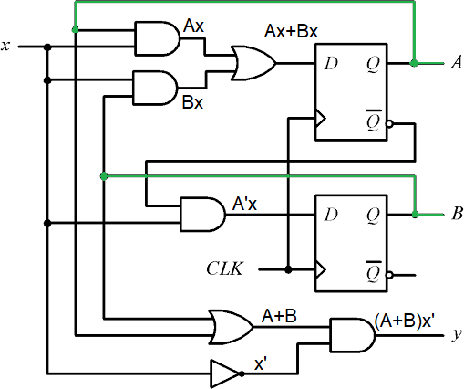
Example 1: Draw the state diagram for the given circuit
1. Find out the input equations of the flip-flop and the output equation
DA = Ax + Bx
DB = A’x
y = (A+B)x’
‹#›
Department of Computer Science and Engineering
CSE260 - Digital Logic Design

Slide 7
Example 1: Draw the state diagram for the given circuit
A |  |  | B |  |  | x |  |  |  | DA | DB | y
0 |  |  | 0 |  |  | 0 |  |  |  | 0 | 0 | 0
0 |  |  | 0 |  |  | 1 |  |  |  | 0 | 1 | 0
0 |  |  | 1 |  |  | 0 |  |  |  | 0 | 0 | 1
0 |  |  | 1 |  |  | 1 |  |  |  | 1 | 1 | 0
1 |  |  | 0 |  |  | 0 |  |  |  | 0 | 0 | 1
1 |  |  | 0 |  |  | 1 |  |  |  | 1 | 0 | 0
1 |  |  | 1 |  |  | 0 |  |  |  | 0 | 0 | 1
1 |  |  | 1 |  |  | 1 |  |  |  | 1 | 0 | 0
2. Construct the state table according to the flip-flop input and output equations
DA = Ax + Bx
DB = A’x
y = (A+B)x’
When A=0, B=0, x=0, DA = 0.0 + 0.0 = 0
DB = 0’.0 = 0
y = (0+0).0’ = 0
When A=0, B=0, x=1, DA = 0.1 + 0.1 = 0
DB = 0’.1 = 1
y = (0+0).1’ = 0
‹#›
Department of Computer Science and Engineering
CSE260 - Digital Logic Design

Slide 8
Example 1: Draw the state diagram for the given circuit
A | B | x |  | DA | DB | y |  | A+ | B+
0 | 0 | 0 |  | 0 | 0 | 0 |  | 0 | 0
0 | 0 | 1 |  | 0 | 1 | 0 |  | 0 | 1
0 | 1 | 0 |  | 0 | 0 | 1 |  | 0 | 0
0 | 1 | 1 |  | 1 | 1 | 0 |  | 1 | 1
1 | 0 | 0 |  | 0 | 0 | 1 |  | 0 | 0
1 | 0 | 1 |  | 1 | 0 | 0 |  | 1 | 0
1 | 1 | 0 |  | 0 | 0 | 1 |  | 0 | 0
1 | 1 | 1 |  | 1 | 0 | 0 |  | 1 | 0
3. Find out the next states from the flip flop input values
D Flip-Flop Truth Table
D | Q
0 | 0
1 | 1
∴ DA = A+
∴ DB = B+
‹#›
Department of Computer Science and Engineering
CSE260 - Digital Logic Design

Slide 9
Example 1: Draw the state diagram for the given circuit
A | B | x |  | A+ | B+ | y
0 | 0 | 0 |  | 0 | 0 | 0
0 | 0 | 1 |  | 0 | 1 | 0
0 | 1 | 0 |  | 0 | 0 | 1
0 | 1 | 1 |  | 1 | 1 | 0
1 | 0 | 0 |  | 0 | 0 | 1
1 | 0 | 1 |  | 1 | 0 | 0
1 | 1 | 0 |  | 0 | 0 | 1
1 | 1 | 1 |  | 1 | 0 | 0
4. Draw the state diagram from the state table
State Diagram
0/0
1/0
10
0/1
00
0/1
1/0 0/1
1/0
1/0
01
11
‹#›
Department of Computer Science and Engineering
CSE260 - Digital Logic Design

Slide 10
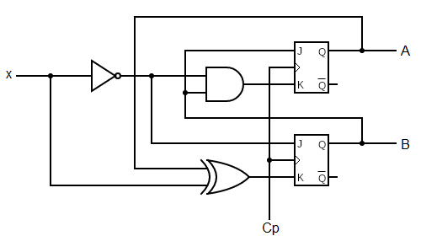
Example 2: Draw the state diagram for the given circuit
Sequential Circuit using JK Flip Flop
Present States: A and B
Next States: A+ and B+
Input: JA, KA, JB, KB, x
‹#›
Department of Computer Science and Engineering
CSE260 - Digital Logic Design

Slide 11
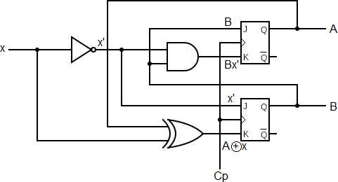
Example 2: Draw the state diagram for the given circuit
1. Find out the input equations of the flip-flop and the output equation
JA = B
KA = Bx’
JB = x’
KB = A xor X
‹#›
Department of Computer Science and Engineering
CSE260 - Digital Logic Design

Slide 12
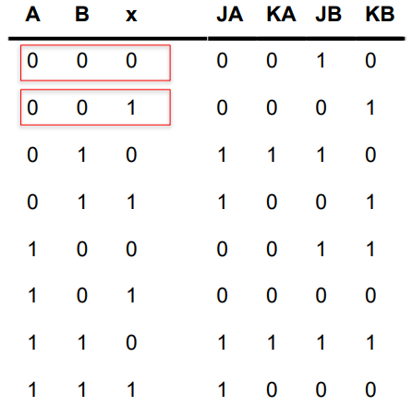
Example 2: Draw the state diagram for the given circuit
2. Construct the state table according to the flip-flop input and output equations
JA = B
KA = Bx’
JB = x’
KB = A xor X
When A=0, B=0, x=0, JA = 0
KA = 0.0’ = 0
JB = 0’ = 1
KB = 0 xor 0 = 0
When A=0, B=0, x=1, JA = 0
KA = 0.1’ = 0
JB = 1’ = 0
KB = 0 xor 0 = 0
‹#›
Department of Computer Science and Engineering
CSE260 - Digital Logic Design

Slide 13
Example 2: Draw the state diagram for the given circuit
A | B | x |  | JA | KA | JB | KB |  | A+ | B+
0 | 0 | 0 |  | 0 | 0 | 1 | 0 |  | 0 | 1
0 | 0 | 1 |  | 0 | 0 | 0 | 1 |  | 0 | 0
0 | 1 | 0 |  | 1 | 1 | 1 | 0 |  | 1 | 1
0 | 1 | 1 |  | 1 | 0 | 0 | 1 |  | 1 | 0
1 | 0 | 0 |  | 0 | 0 | 1 | 1 |  | 1 | 1
1 | 0 | 1 |  | 0 | 0 | 0 | 0 |  | 1 | 0
1 | 1 | 0 |  | 1 | 1 | 1 | 1 |  | 0 | 0
1 | 1 | 1 |  | 1 | 0 | 0 | 0 |  | 1 | 1
3. Find out the next states from the flip flop input values
JK Flip-Flop Truth Table
J | K | Q
0 | 0 | Memory/ No Change
0 | 1 | 0
1 | 0 | 1
1 | 1 | Toggle
‹#›
Department of Computer Science and Engineering
CSE260 - Digital Logic Design

Slide 14
Example 2: Draw the state diagram for the given circuit
A | B | x |  | A+ | B+
0 | 0 | 0 |  | 0 | 1
0 | 0 | 1 |  | 0 | 0
0 | 1 | 0 |  | 1 | 1
0 | 1 | 1 |  | 1 | 0
1 | 0 | 0 |  | 1 | 1
1 | 0 | 1 |  | 1 | 0
1 | 1 | 0 |  | 0 | 0
1 | 1 | 1 |  | 1 | 1
4. Draw the state diagram from the state table
State Diagram
1
1
11
0
00
0
0
0
1
01
10
1
‹#›
Department of Computer Science and Engineering
CSE260 - Digital Logic Design

Slide 15
State Diagram to Circuit Diagram
‹#›
Department of Computer Science and Engineering
CSE260 - Digital Logic Design

Slide 16
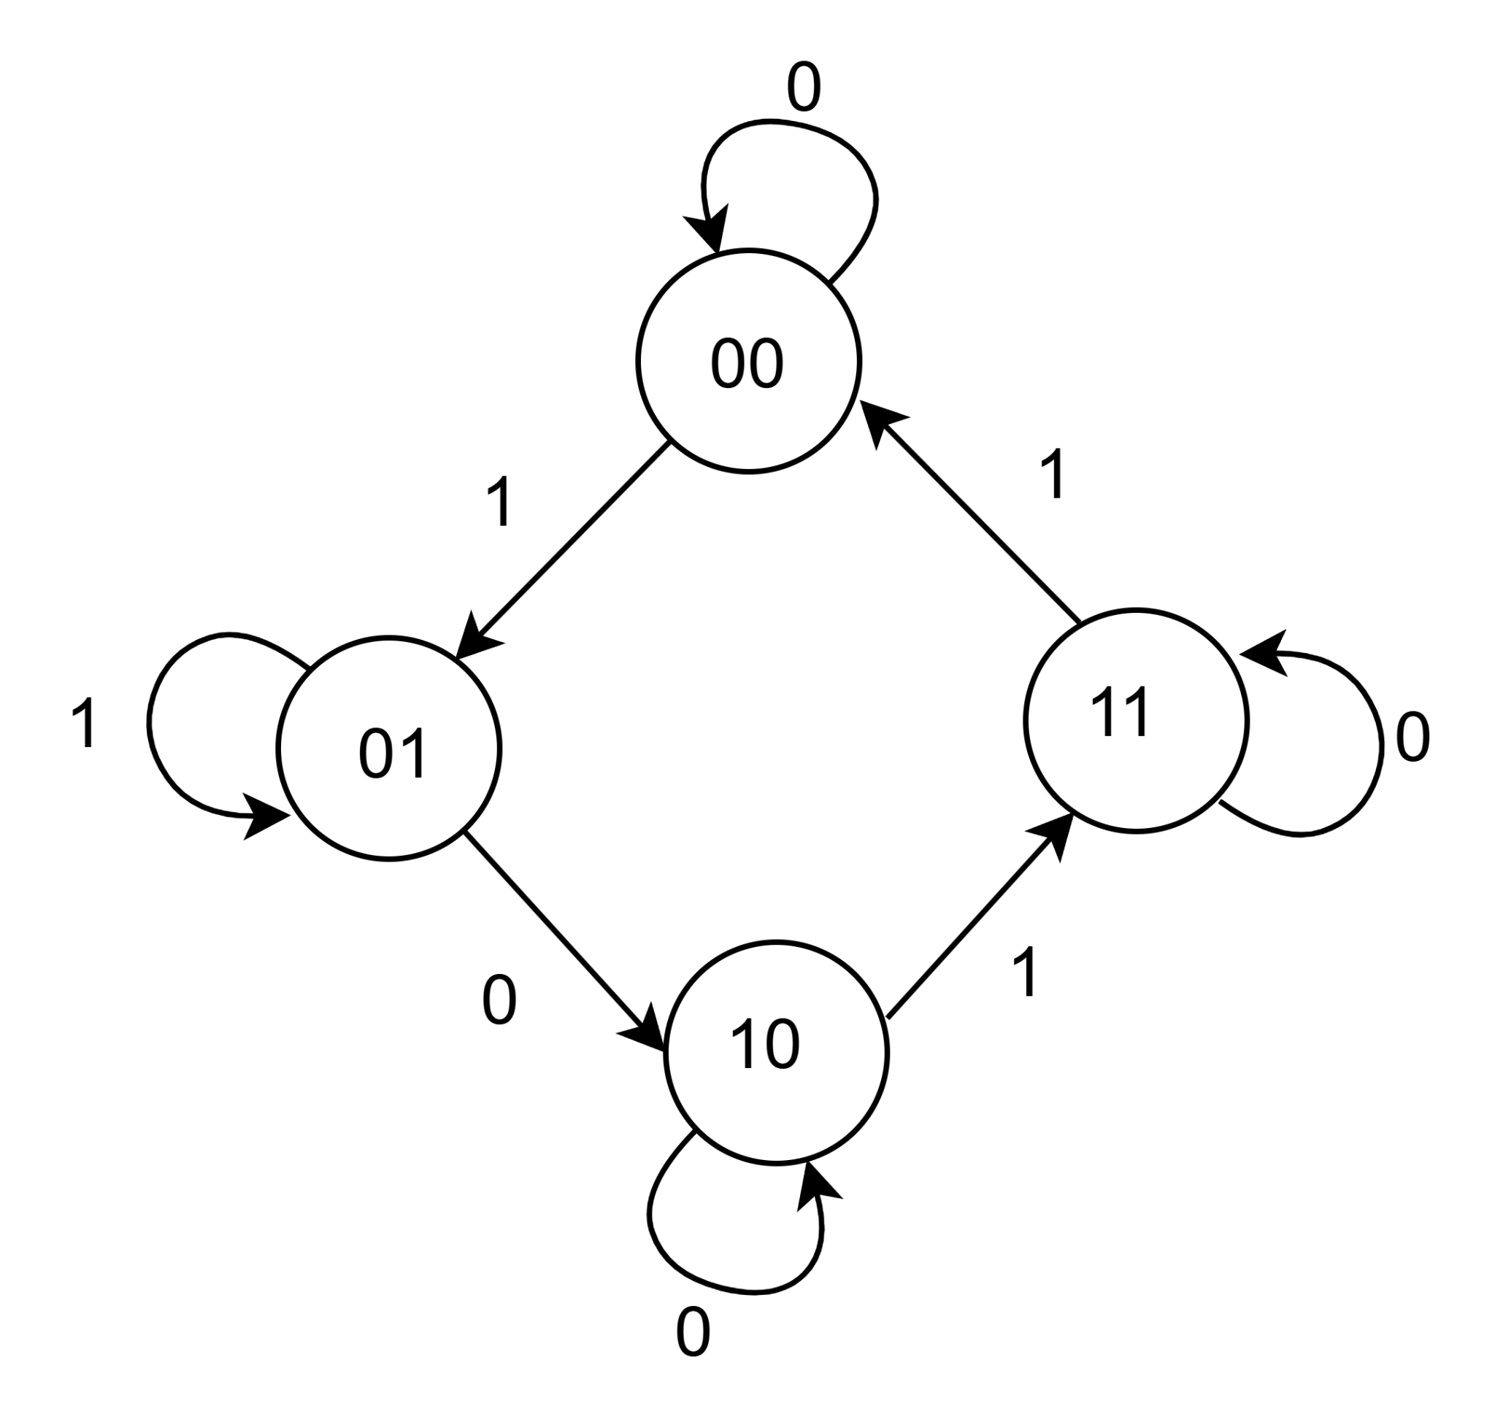
Design Example 1:
Given state diagram as follows, get the sequential circuit using JK Flip Flop
‹#›
Department of Computer Science and Engineering
CSE260 - Digital Logic Design

Slide 17
State Diagram to Sequential Circuit Design Workflow
Steps: |  | Description:
1 | Build State table | List Present and Next States Transitions with corresponding inputs. Include outputs if required
2 | Determine Number of Flip-flops | If the number of states = n, then the number of flip-flops (m) required will be: m = ⌈log₂(n)⌉
3 | Create Excitation Table | Determine and Populate Flip-Flop input columns based on present and next states using the excitation table.
4 | Derive Input Functions using K-Map | Find each FF input and output function using n-variable K-Map. [n depends on the total number of present states and inputs]
5 | Design Logic Diagram | Draw sequential circuit using logic gates and flip-flops based on the equations found in Step-4
‹#›
Department of Computer Science and Engineering
CSE260 - Digital Logic Design

Slide 18
Design Example 1: State Table
Present State | Next State
 | X = 0 | X = 1
AB | A⁺B⁺ | A⁺B⁺
00 | 00 | 01
01 | 10 | 01
10 | 10 | 11
11 | 11 | 00
Present State |  | Input | Next State |  | Flip-Flop Inputs
A | B | X | A⁺ | B⁺ | JA | KA | JB | KB
0 | 0 | 0 | 0 | 0 | 0 | x | 0 | x
0 | 0 | 1 | 0 | 1 | 0 | x | 1 | x
0 | 1 | 0 | 1 | 0 | 1 | x | x | 1
0 | 1 | 1 | 0 | 1 | 0 | x | x | 0
1 | 0 | 0 | 1 | 0 | x | 0 | 0 | x
1 | 0 | 1 | 1 | 1 | x | 0 | 1 | x
1 | 1 | 0 | 1 | 1 | x | 0 | x | 0
1 | 1 | 1 | 0 | 0 | x | 1 | x | 1
Q | Q⁺ | J | K
0 | 0 | 0 | X
0 | 1 | 1 | X
1 | 0 | X | 1
1 | 1 | X | 0
JK Flip-Flop’s excitation table
‹#›
Department of Computer Science and Engineering
CSE260 - Digital Logic Design

Slide 19
⊐
Design Example 1: Get FF input function using K-Map
Present State |  | Input | Next State |  | Flip-Flop Inputs
A | B | X | A⁺ | B⁺ | JA | KA | JB | KB
0 | 0 | 0 | 0 | 0 | 0 | x | 0 | x
0 | 0 | 1 | 0 | 1 | 0 | x | 1 | x
0 | 1 | 0 | 1 | 0 | 1 | x | x | 1
0 | 1 | 1 | 0 | 1 | 0 | x | x | 0
1 | 0 | 0 | 1 | 0 | x | 0 | 0 | x
1 | 0 | 1 | 1 | 1 | x | 0 | 1 | x
1 | 1 | 0 | 1 | 1 | x | 0 | x | 0
1 | 1 | 1 | 0 | 0 | x | 1 | x | 1
Bx
A
00 01 11 10
0
1
 |  |  | 1
X | X | X | X
JA = B.x’
Bx
A
00 01 11 10
0
1
X | X | X | X
 |  | 1
Bx
Bx
A
00 01 11 10
A
00 01 11 10
KA = B.x
0
1
 | 1 | X | X
 | 1 | X | X
0
1
X | X |  | 1
X | X | 1
JB= x
KB= (A ⊕ x)’
‹#›
Department of Computer Science and Engineering
CSE260 - Digital Logic Design

Slide 20
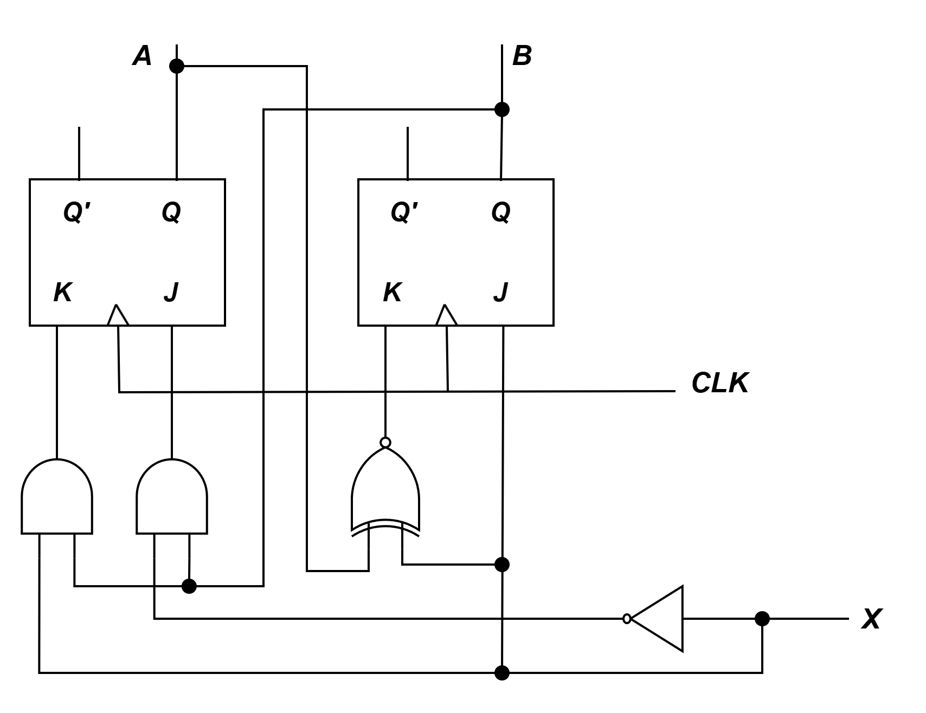
Design Example 1:
Logic Diagram
Input Flip-Flop Functions:
JA = B.x’
KA = B.x
JB= x
KB= (A ⊕ x)’
Note: You can draw the circuit any way you wish (Horizontally or Vertically)
‹#›
Department of Computer Science and Engineering
CSE260 - Digital Logic Design

Slide 21
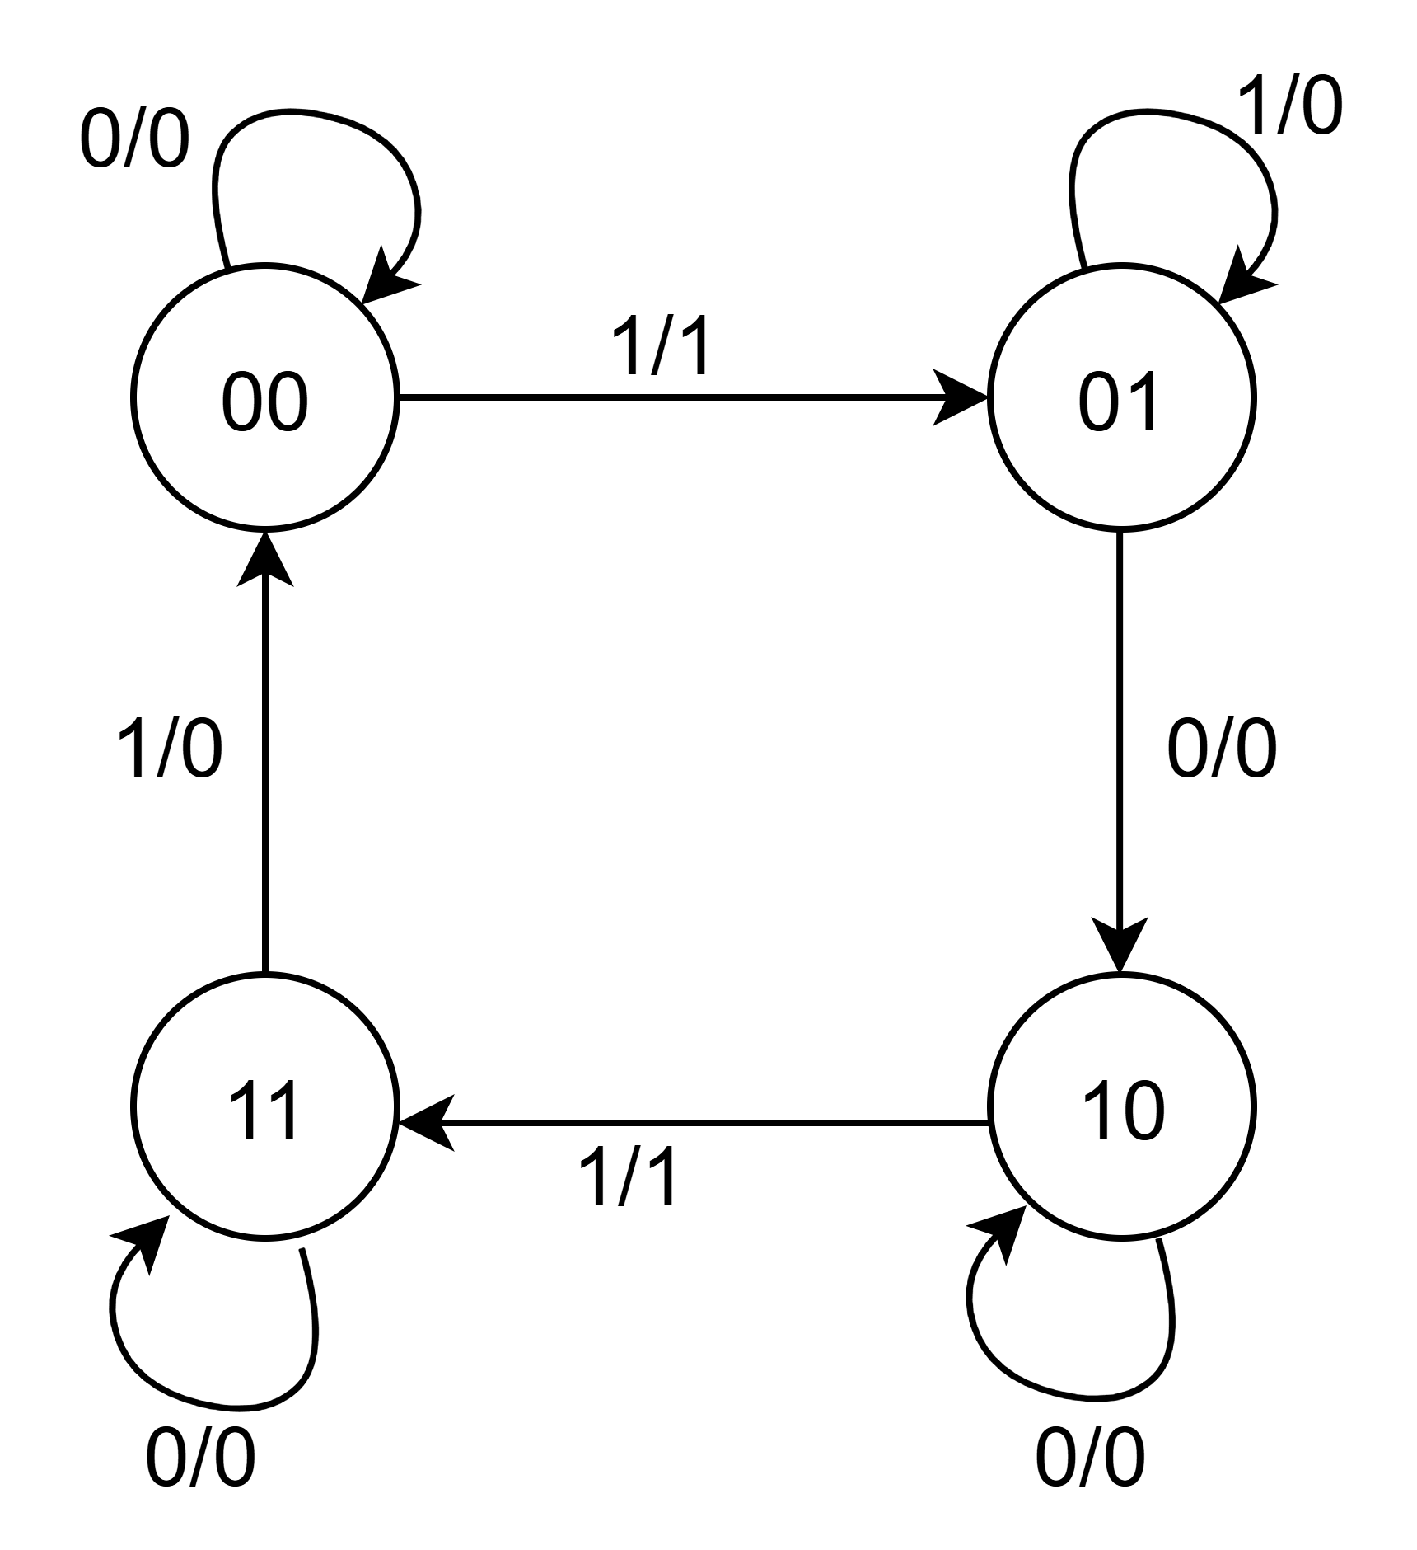
Design Example 2:
Design, using D flip-flop, circuit is based on state table below. (Exercise: How if using JK flip-flop)
Present State |  | Input | Next State |  | Output
A | B | X | A⁺ | B⁺ | Y
0 | 0 | 0 | 0 | 0 | 0
0 | 0 | 1 | 0 | 1 | 1
0 | 1 | 0 | 1 | 0 | 0
0 | 1 | 1 | 0 | 1 | 0
1 | 0 | 0 | 1 | 0 | 0
1 | 0 | 1 | 1 | 1 | 1
1 | 1 | 0 | 1 | 1 | 0
1 | 1 | 1 | 0 | 0 | 0
‹#›
Department of Computer Science and Engineering
CSE260 - Digital Logic Design

Slide 22
Design Example 2: Determine FF- Input and Y output
Present State |  | Input | Next State |  | Output | Inputs
A | B | X | A⁺ | B⁺ | Y | DA | DB
0 | 0 | 0 | 0 | 0 | 0 | 0 | 0
0 | 0 | 1 | 0 | 1 | 1 | 0 | 1
0 | 1 | 0 | 1 | 0 | 0 | 1 | 0
0 | 1 | 1 | 0 | 1 | 0 | 0 | 1
1 | 0 | 0 | 1 | 0 | 0 | 1 | 0
1 | 0 | 1 | 1 | 1 | 1 | 1 | 1
1 | 1 | 0 | 1 | 1 | 0 | 1 | 1
1 | 1 | 1 | 0 | 0 | 0 | 0 | 0
Q | Q⁺ | D
0 | 0 | 0
0 | 1 | 1
1 | 0 | 0
1 | 1 | 1
D - Flip Flop
Bx
Bx
Bx
A
00 01 11 10
A
00 01 11 10
A
00 01 11 10
0
1
 |  |  | 1
1 | 1 |  | 1
0
1
 | 1 | 1
 | 1 |  | 1
0
1
 | 1
 | 1
DA= A.B’ + B.x’
DB= A’.x + B’.x + A.B.x’
Y= B’.x
‹#›
Department of Computer Science and Engineering
CSE260 - Digital Logic Design

Slide 23
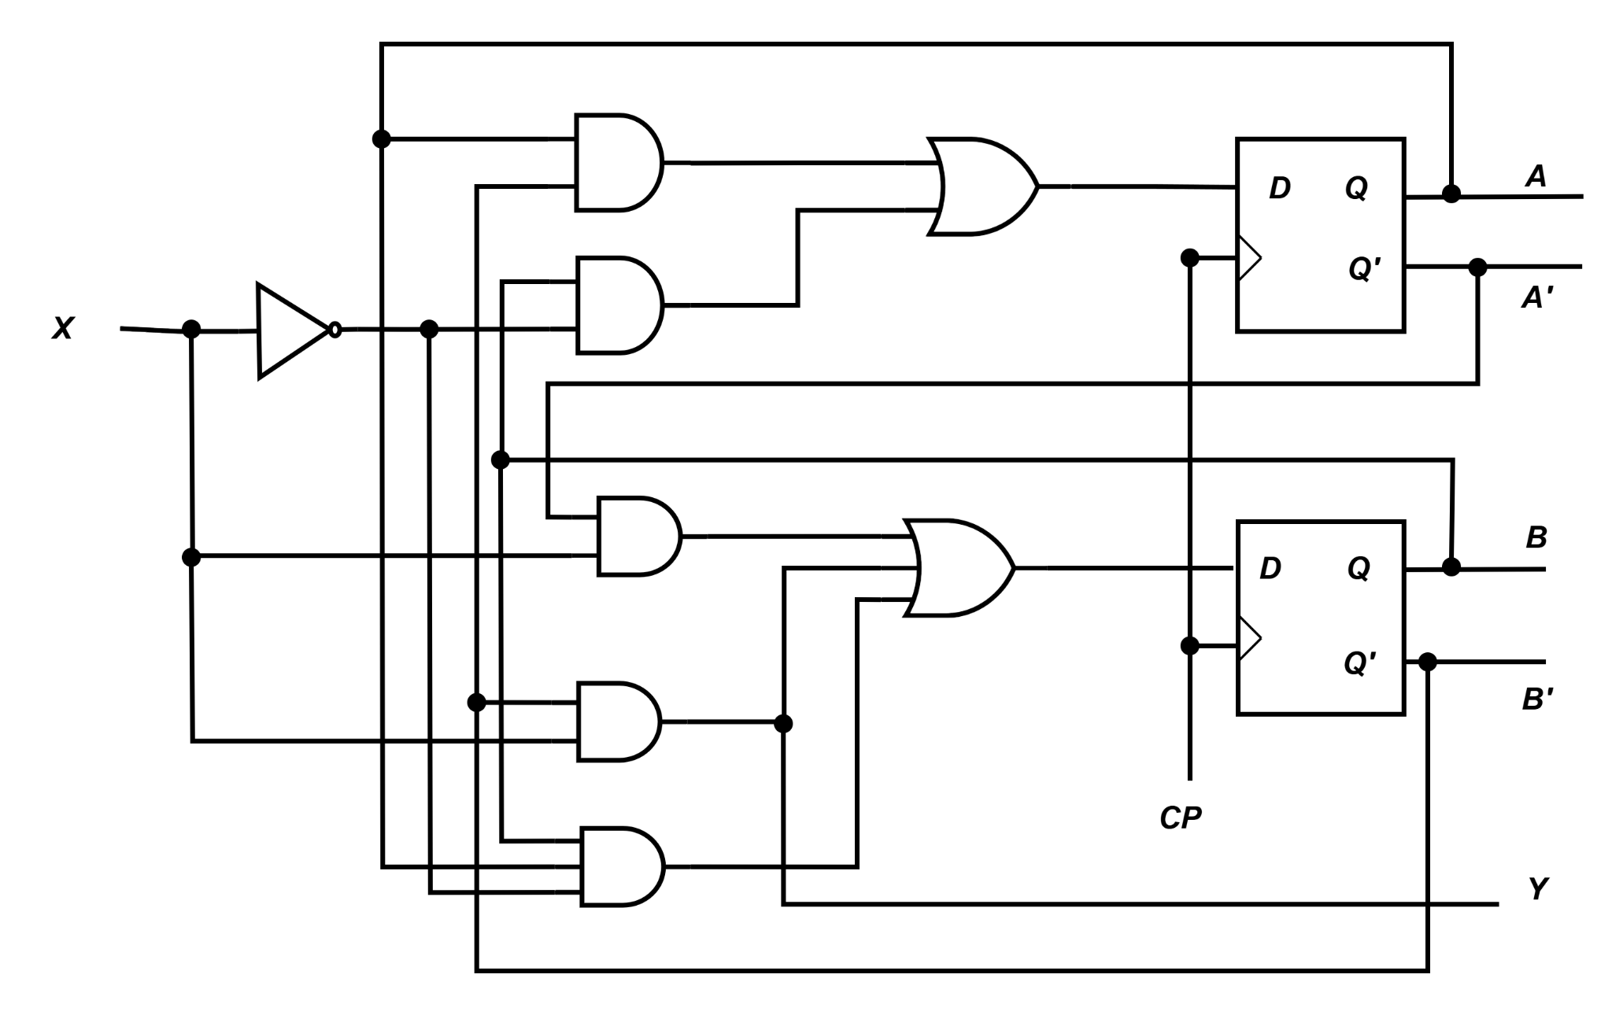
Design Example 2:
Logic Diagram
Input Flip-Flop Functions:
DA = A.B’ + B.x’
DB = A.x + B’.x + A.B.x’
Y = B’.x
‹#›
Department of Computer Science and Engineering
CSE260 - Digital Logic Design

Slide 24
Introduction: Counters
Counters are circuits that cycle through a specified number of states.
Two types of counters:
synchronous (parallel) counters
asynchronous (ripple) counters
Ripple counters allow some flip-flop outputs to be used as a source of clock for other flip-flops.
Synchronous counters apply the same clock to all flip-flops.
We will cover only synchronous this time
‹#›
Department of Computer Science and Engineering
CSE260 - Digital Logic Design

Slide 25
Synchronous (Parallel) Counters
Synchronous (parallel) counters: the flip-flops are clocked at the same time by a common clock pulse.
We can design these counters using the sequential logic design process.
Example: 2-bit synchronous binary counter (using T flip-flops, or JK flip-flops with identical J,K inputs).
‹#›
Department of Computer Science and Engineering
CSE260 - Digital Logic Design

Slide 26
Synchronous (Parallel) Counters
Question: Design a 2-bit synchronous binary counter (using T flip-flops).
Start by drawing this
Present State |  | Next State |  | Flip-Flop Inputs
A₁ | A₀ | A₁⁺ | A₀⁺ | TA₁ | TA₀
0 | 0 | 0 | 1 | 0 | 1
0 | 1 | 1 | 0 | 1 | 1
1 | 0 | 1 | 1 | 0 | 1
1 | 1 | 0 | 0 | 1 | 1
00
01
11
10
Q_{n} | Q_{n+1} | T
0 | 0 | 0
0 | 1 | 1
1 | 0 | 1
1 | 1 | 0
Excitation table of T Flip-Flop
‹#›
Department of Computer Science and Engineering
CSE260 - Digital Logic Design

Slide 27
Synchronous (Parallel) Counters
Question: Design a 2-bit synchronous binary counter (using T flip-flops).
Next, find out the equations for the flip-flop inputs.
TA1 = A1’A0 + A1A0 = A0 (A1’+A1) = A0
TA0 = 1
FYI, these can also be calculated using K-Maps
Present State |  | Next State |  | Flip-Flop Inputs
A₁ | A₀ | A₁⁺ | A₀⁺ | TA₁ | TA₀
0 | 0 | 0 | 1 | 0 | 1
0 | 1 | 1 | 0 | 1 | 1
1 | 0 | 1 | 1 | 0 | 1
1 | 1 | 0 | 0 | 1 | 1
A0
A0
A1
A0’ A0
A1
A0’ A0
 | 1
 | 1
TA₀= 1
A1’
A1
TA₁= A0
1 | 1
1 | 1
A1’
A1
‹#›
Department of Computer Science and Engineering
CSE260 - Digital Logic Design

Slide 28
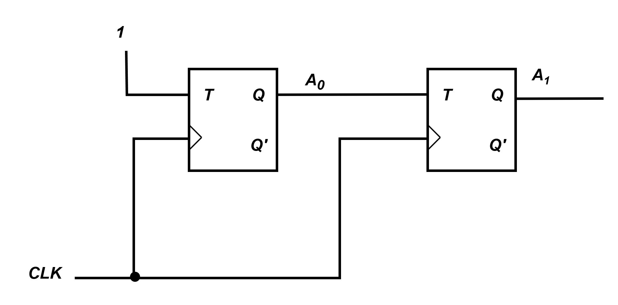
Synchronous (Parallel) Counters
TA1 = A1’A0 + A1A0 = A0 (A1’+A1) = A0
TA0 = 1
Finally, draw the circuit diagram
‹#›
Department of Computer Science and Engineering
CSE260 - Digital Logic Design

Slide 29
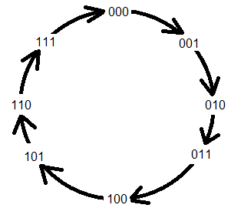
Synchronous (Parallel) Counters
Question: Design a 3-bit synchronous binary counter (using T FF).
Start by drawing this
Present State |  |  | Next State |  |  | Flip-Flop Inputs
A₂ | A₁ | A₀ | A₂⁺ | A₁⁺ | A₀⁺ | TA₂ | TA₁ | TA₀
0 | 0 | 0 | 0 | 0 | 1 | 0 | 0 | 1
0 | 0 | 1 | 0 | 1 | 0 | 0 | 1 | 1
0 | 1 | 0 | 0 | 1 | 1 | 0 | 0 | 1
0 | 1 | 1 | 1 | 0 | 0 | 1 | 1 | 1
1 | 0 | 0 | 1 | 0 | 1 | 0 | 0 | 1
1 | 0 | 1 | 1 | 1 | 0 | 0 | 1 | 1
1 | 1 | 0 | 1 | 1 | 1 | 0 | 0 | 1
1 | 1 | 1 | 0 | 0 | 0 | 1 | 1 | 1
Q_{n} | Q_{n+1} | T
0 | 0 | 0
0 | 1 | 1
1 | 0 | 1
1 | 1 | 0
Excitation table of
T Flip-Flop
‹#›
Department of Computer Science and Engineering
CSE260 - Digital Logic Design

Slide 30
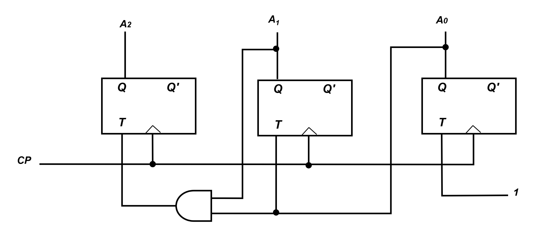
Synchronous (Parallel) Counters
A1A0
A1A0
A1A0
A2
A2
00 01 11 10
A2
00 01 11 10
00 01 11 10
0
1
 | 1 | 1
 | 1 | 1
1 | 1 | 1 | 1
1 | 1 | 1 | 1
0
1
 |  | 1
 |  | 1
0
1
TA₂= A₁.A₀
TA₁= A₀
TA₀= 1
Draw the circuit Diagram
‹#›
Department of Computer Science and Engineering
CSE260 - Digital Logic Design

Slide 31
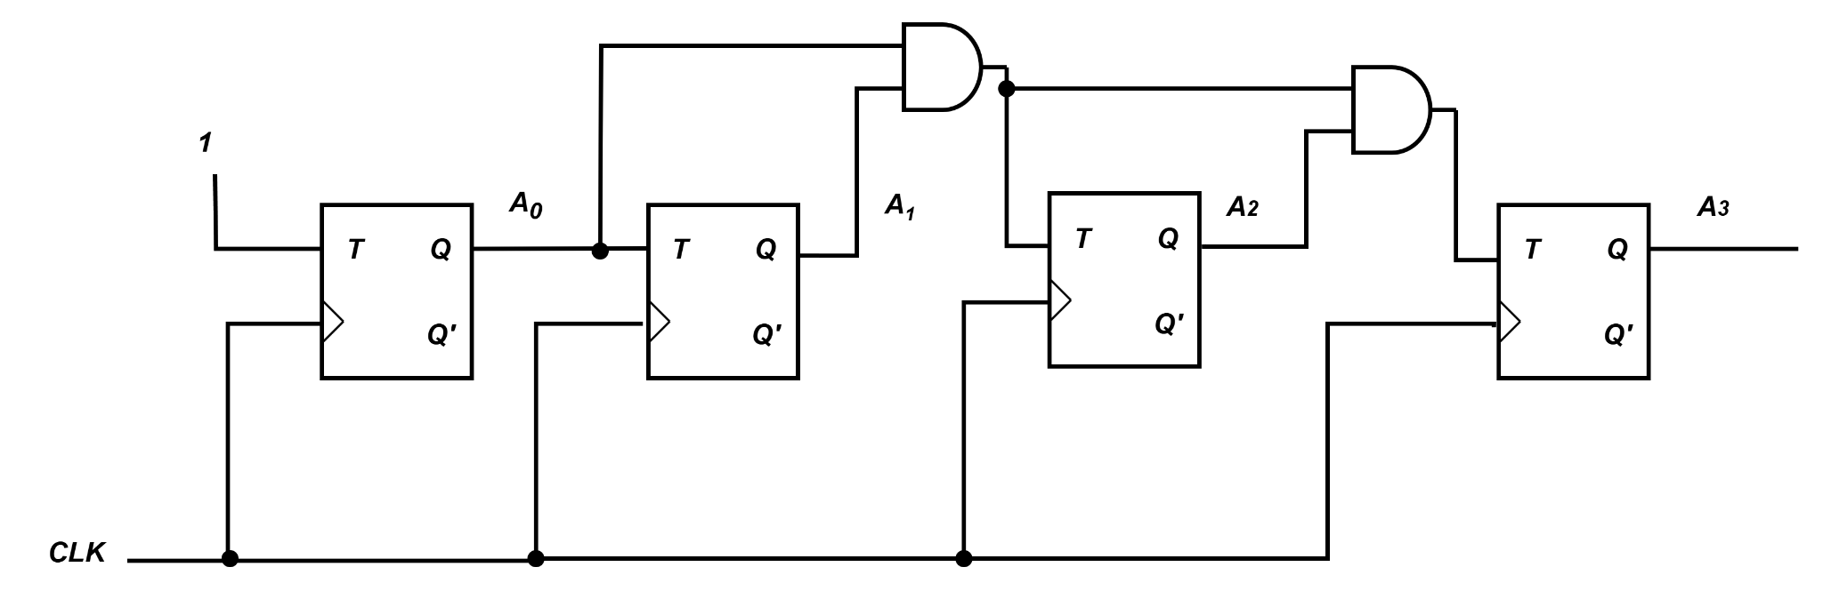
Self Study
4-bit Synchronous up counter (Try it Yourself)
Equations and diagram will look like the following:
TA₃ = A₂ . A₁ . A₀
TA₂ = A₁ . A₀
TA₁ = A₀
TA₀ = 1
‹#›
Department of Computer Science and Engineering
CSE260 - Digital Logic Design

Slide 32
Up/Down Synchronous Counters
Up/down synchronous counter: a bidirectional counter that is capable of counting either up or down.
An input (control) line Up/Down (or simply Up) specifies the direction of counting.
Up/Down = 0 → Count upward
Up/Down = 1 → Count downward
‹#›
Department of Computer Science and Engineering
CSE260 - Digital Logic Design

Slide 33
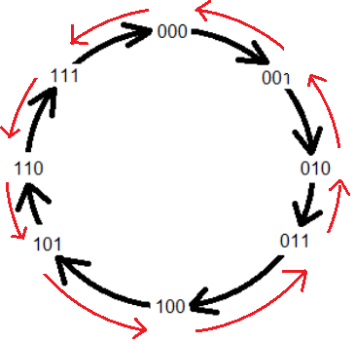
3- bit Up/Down Synchronous Counters
U/D | Present State |  |  | Next State |  |  | Flip-Flop Inputs
M | Q₂ | Q₁ | Q₀ | Q₂⁺ | Q₁⁺ | Q₀⁺ | TQ₂ | TQ₁ | TQ₀
0 | 0 | 0 | 0 | 0 | 0 | 1 | 0 | 0 | 1
0 | 0 | 0 | 1 | 0 | 1 | 0 | 0 | 1 | 1
0 | 0 | 1 | 0 | 0 | 1 | 1 | 0 | 0 | 1
0 | 0 | 1 | 1 | 1 | 0 | 0 | 1 | 1 | 1
0 | 1 | 0 | 0 | 1 | 0 | 1 | 0 | 0 | 1
0 | 1 | 0 | 1 | 1 | 1 | 0 | 0 | 1 | 1
0 | 1 | 1 | 0 | 1 | 1 | 1 | 0 | 0 | 1
0 | 1 | 1 | 1 | 0 | 0 | 0 | 1 | 1 | 1
1 | 0 | 0 | 0 | 1 | 1 | 1 | 1 | 1 | 1
1 | 0 | 0 | 1 | 0 | 0 | 0 | 0 | 0 | 1
1 | 0 | 1 | 0 | 0 | 0 | 1 | 0 | 1 | 1
1 | 0 | 1 | 1 | 0 | 1 | 0 | 0 | 0 | 1
1 | 1 | 0 | 0 | 0 | 1 | 1 | 1 | 1 | 1
1 | 1 | 0 | 1 | 1 | 0 | 0 | 0 | 0 | 1
1 | 1 | 1 | 0 | 1 | 0 | 1 | 0 | 1 | 1
1 | 1 | 1 | 1 | 1 | 1 | 0 | 0 | 0 | 1
Q_{n} | Q_{n+1} | T
0 | 0 | 0
0 | 1 | 1
1 | 0 | 1
1 | 1 | 0
Excitation table of
T Flip-Flop
Reference Video
‹#›
Department of Computer Science and Engineering
CSE260 - Digital Logic Design

Slide 34
3- bit Up/Down Synchronous Counters
U/D | Present State |  |  | Next State |  |  | Flip-Flop Inputs
M | Q₂ | Q₁ | Q₀ | Q₂⁺ | Q₁⁺ | Q₀⁺ | TQ₂ | TQ₁ | TQ₀
0 | 0 | 0 | 0 | 0 | 0 | 1 | 0 | 0 | 1
0 | 0 | 0 | 1 | 0 | 1 | 0 | 0 | 1 | 1
0 | 0 | 1 | 0 | 0 | 1 | 1 | 0 | 0 | 1
0 | 0 | 1 | 1 | 1 | 0 | 0 | 1 | 1 | 1
0 | 1 | 0 | 0 | 1 | 0 | 1 | 0 | 0 | 1
0 | 1 | 0 | 1 | 1 | 1 | 0 | 0 | 1 | 1
0 | 1 | 1 | 0 | 1 | 1 | 1 | 0 | 0 | 1
0 | 1 | 1 | 1 | 0 | 0 | 0 | 1 | 1 | 1
1 | 0 | 0 | 0 | 1 | 1 | 1 | 1 | 1 | 1
1 | 0 | 0 | 1 | 0 | 0 | 0 | 0 | 0 | 1
1 | 0 | 1 | 0 | 0 | 0 | 1 | 0 | 1 | 1
1 | 0 | 1 | 1 | 0 | 1 | 0 | 0 | 0 | 1
1 | 1 | 0 | 0 | 0 | 1 | 1 | 1 | 1 | 1
1 | 1 | 0 | 1 | 1 | 0 | 0 | 0 | 0 | 1
1 | 1 | 1 | 0 | 1 | 0 | 1 | 0 | 1 | 1
1 | 1 | 1 | 1 | 1 | 1 | 0 | 0 | 0 | 1
Q₁Q₀
Q₁Q₀
MQ₂
00 01 11 10
MQ₂
00 01 11 10
00
01
11
10
 |  | 1
 |  | 1
1
1
 | 1 | 1
 | 1 | 1
1 |  |  | 1
1 |  |  | 1
00
01
11
10
TQ₂ =M’Q₁Q₀ + MQ₁’Q₀’
TQ₁ =M’Q₀ + MQ₀’
Q₁Q₀
MQ₂
00 01 11 10
00
01
11
10
1 | 1 | 1 | 1
1 | 1 | 1 | 1
1 | 1 | 1 | 1
1 | 1 | 1 | 1
Reference Video
TQ₀ = 1
‹#›
Department of Computer Science and Engineering
CSE260 - Digital Logic Design

Slide 35
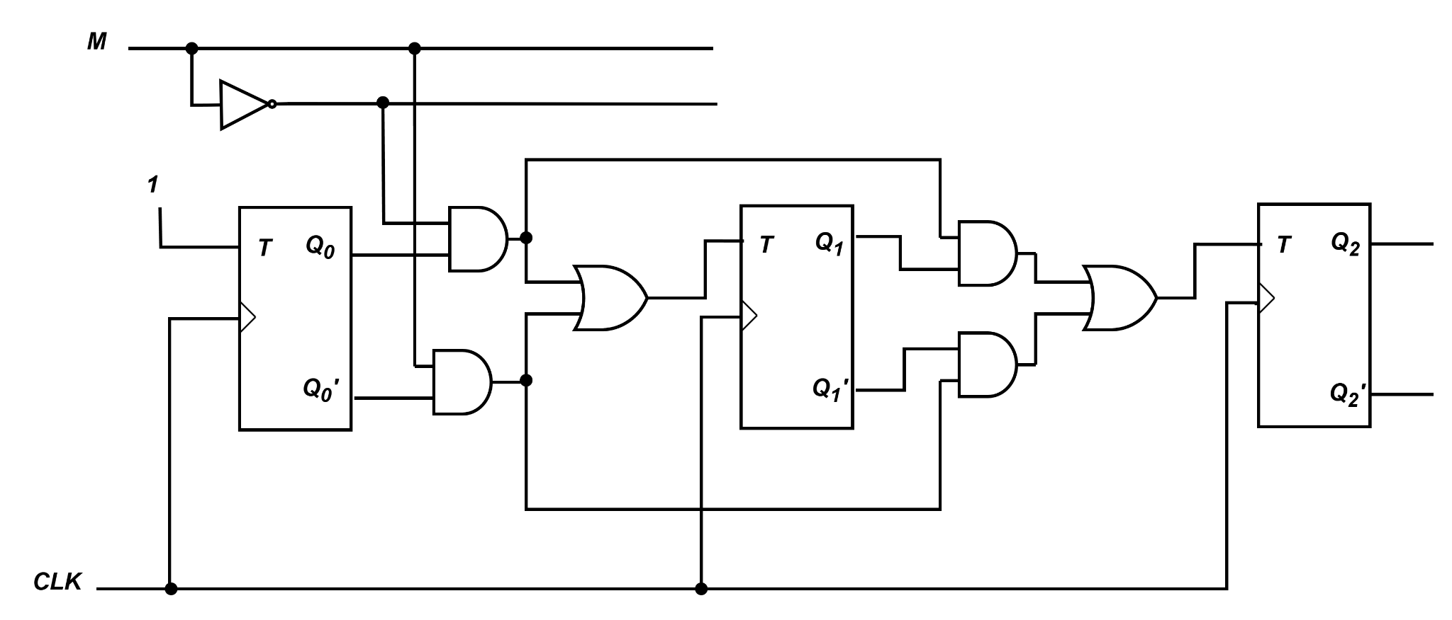
3- bit Up/Down Synchronous Counters
Draw the circuit diagram
(The number of present state will be equal to the number of flip-flops in the circuit)
Reference Video
‹#›
Department of Computer Science and Engineering
CSE260 - Digital Logic Design

Slide 36
Practice Problems using Counters
‹#›
Department of Computer Science and Engineering
CSE260 - Digital Logic Design

Slide 37
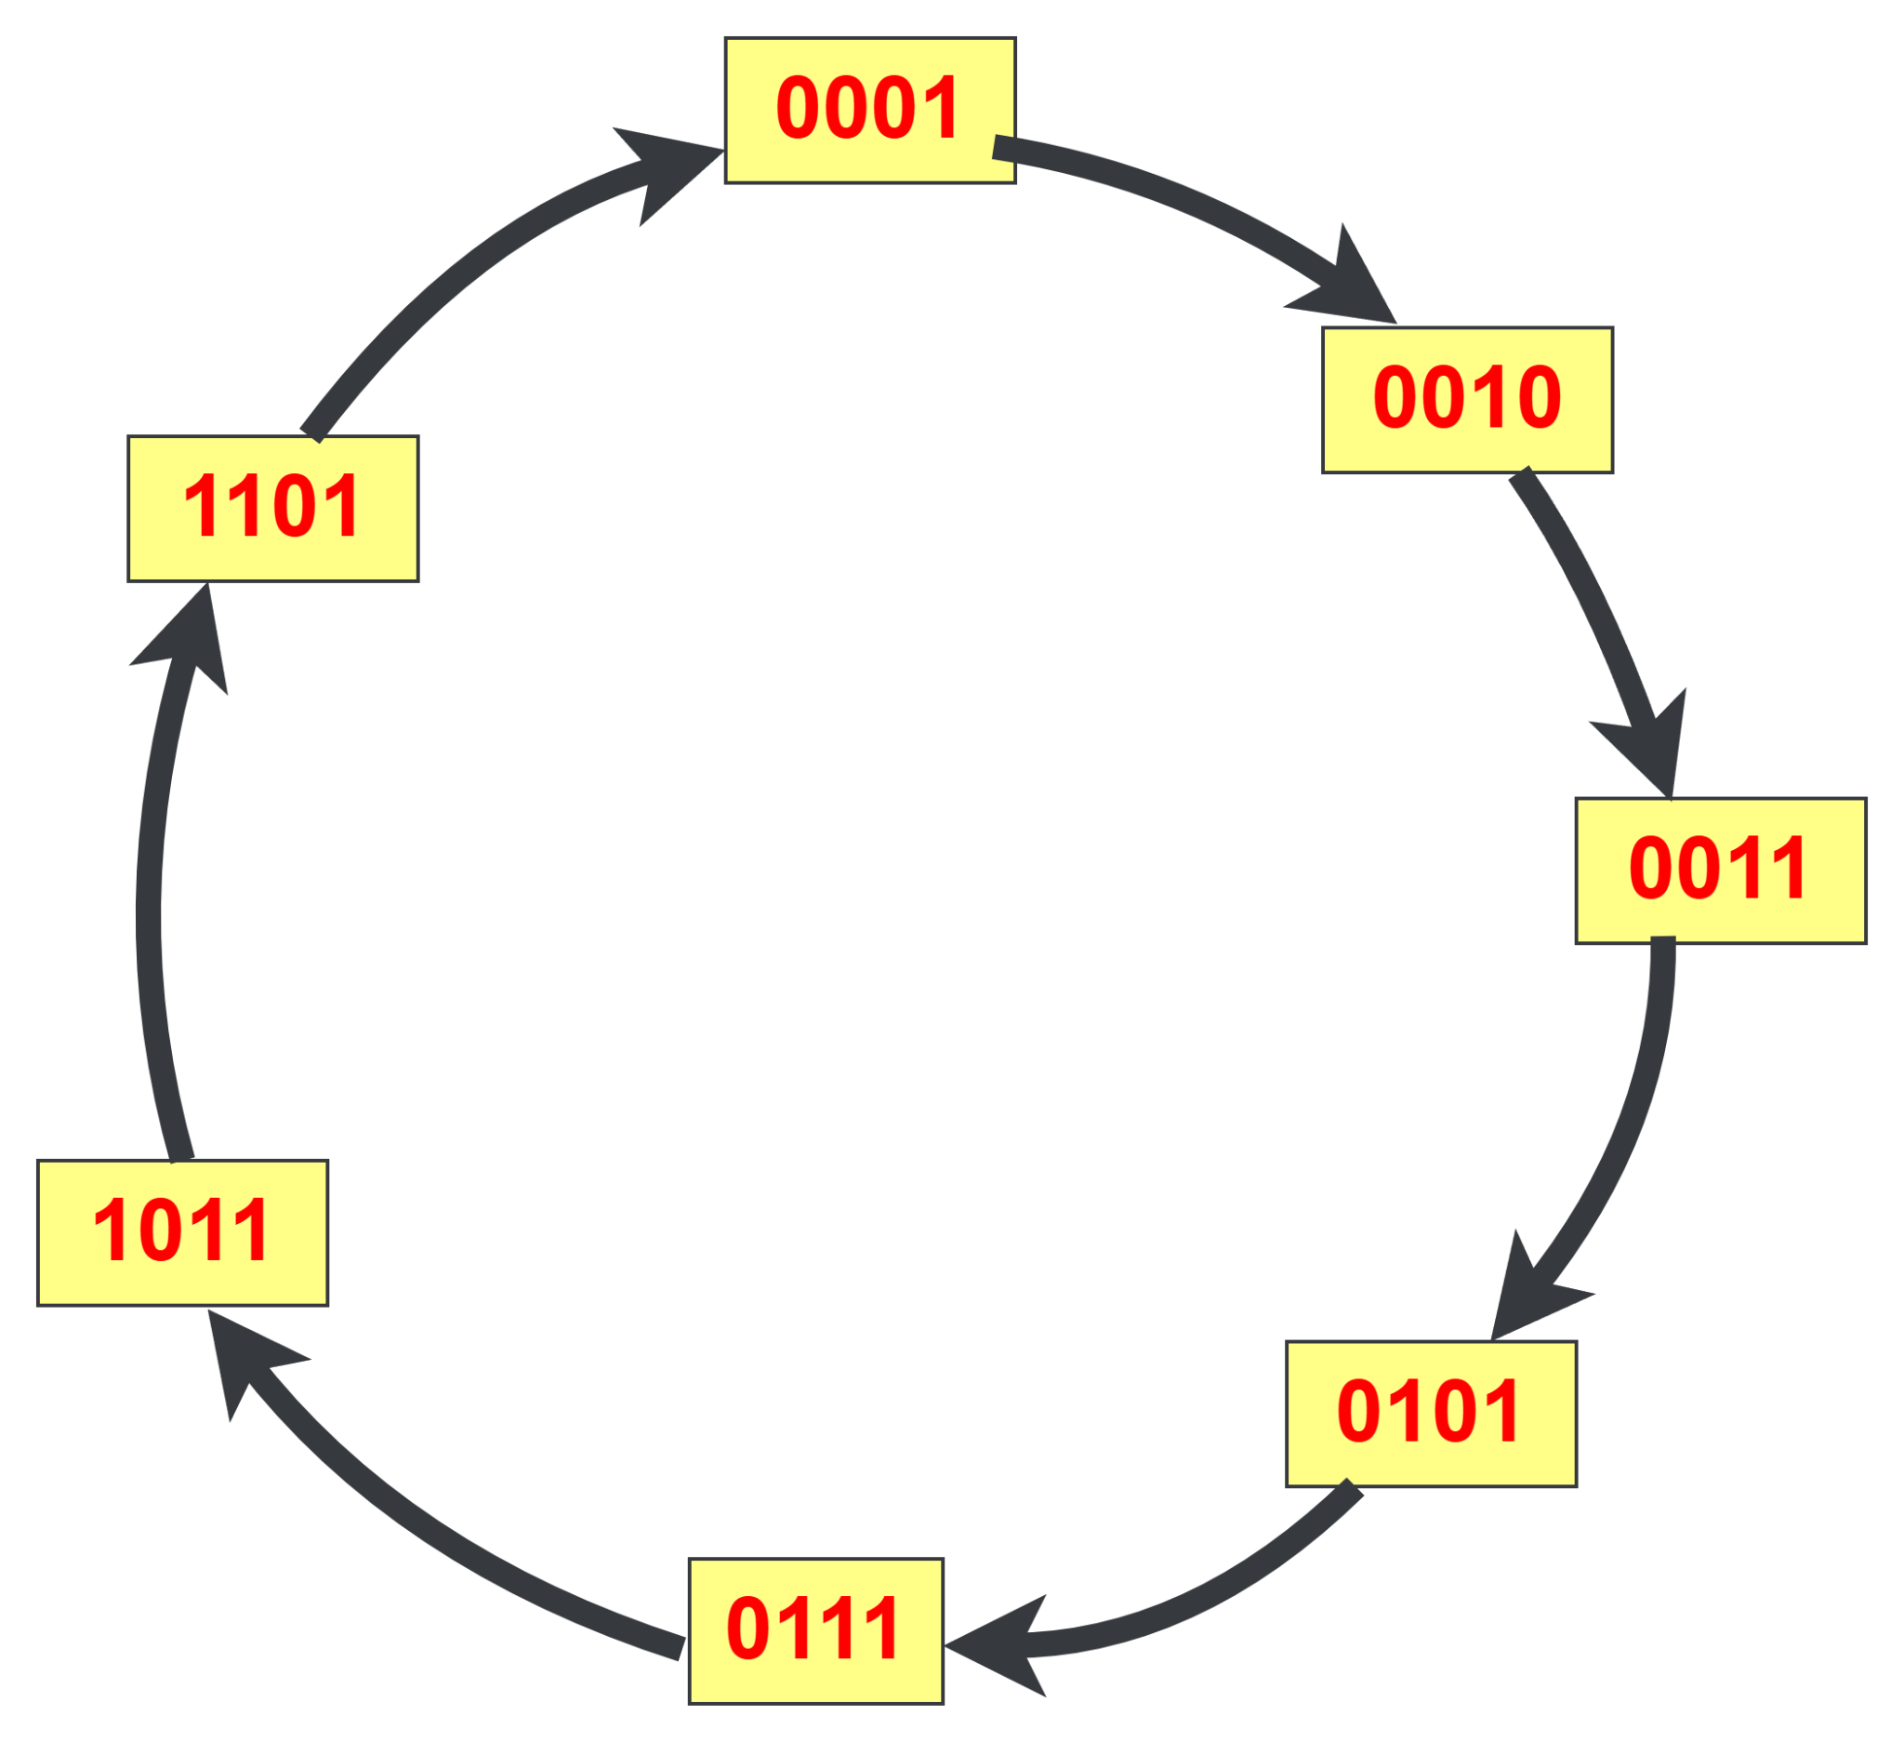

Practice Problem - 1
Implement the following counter using T FF:
1—>2—>3—>5—>7—>11—>13—>1
Start by drawing this
‹#›
Department of Computer Science and Engineering
CSE260 - Digital Logic Design

Slide 38
Practice Problem - 1
Present State |  |  |  | Next State |  |  |  | Flip-Flop Inputs
A₃ | A₂ | A₁ | A₀ | A₃⁺ | A₂⁺ | A₁⁺ | A₀⁺ | TA₃ | TA₂ | TA₁ | TA₀
0 | 0 | 0 | 0 | 0 | 0 | 0 | 1 | 0 | 0 | 0 | 1
0 | 0 | 0 | 1 | 0 | 0 | 1 | 0 | 0 | 0 | 1 | 1
0 | 0 | 1 | 0 | 0 | 0 | 1 | 1 | 0 | 0 | 0 | 1
0 | 0 | 1 | 1 | 0 | 1 | 0 | 1 | 0 | 1 | 1 | 0
0 | 1 | 0 | 0 | 0 | 0 | 0 | 1 | 0 | 1 | 0 | 1
0 | 1 | 0 | 1 | 0 | 1 | 1 | 1 | 0 | 0 | 1 | 0
0 | 1 | 1 | 0 | 0 | 0 | 0 | 1 | 0 | 1 | 1 | 1
0 | 1 | 1 | 1 | 1 | 0 | 1 | 1 | 1 | 1 | 0 | 0
1 | 0 | 0 | 0 | 0 | 0 | 0 | 1 | 1 | 0 | 0 | 1
1 | 0 | 0 | 1 | 0 | 0 | 0 | 1 | 1 | 0 | 0 | 0
1 | 0 | 1 | 0 | 0 | 0 | 0 | 1 | 1 | 0 | 1 | 1
1 | 0 | 1 | 1 | 1 | 1 | 0 | 1 | 0 | 1 | 1 | 0
1 | 1 | 0 | 0 | 0 | 0 | 0 | 1 | 1 | 1 | 0 | 1
1 | 1 | 0 | 1 | 0 | 0 | 0 | 1 | 1 | 1 | 0 | 0
1 | 1 | 1 | 0 | 0 | 0 | 0 | 1 | 1 | 1 | 1 | 1
1 | 1 | 1 | 1 | 0 | 0 | 0 | 1 | 1 | 1 | 1 | 0
Q_{n} | Q_{n+1} | T
0 | 0 | 0
0 | 1 | 1
1 | 0 | 1
1 | 1 | 0
For present states not mentioned in the question, next state will be the INITIAL STATE [0001 in this question].
It’s important to show the states that are not mentioned in the question. Otherwise, the circuit will stop working if any of those states show up.
‹#›
Department of Computer Science and Engineering
CSE260 - Digital Logic Design

Slide 39
Practice Problem - 1
A₁A₀
A₃A₂
A₁’A₀’ A₁’A₀ A₁A₀ A₁A₀’
Present State |  |  |  | Next State |  |  |  | Flip-Flop Inputs
A₃ | A₂ | A₁ | A₀ | A₃⁺ | A₂⁺ | A₁⁺ | A₀⁺ | TA₃ | TA₂ | TA₁ | TA₀
0 | 0 | 0 | 0 | 0 | 0 | 0 | 1 | 0 | 0 | 0 | 1
0 | 0 | 0 | 1 | 0 | 0 | 1 | 0 | 0 | 0 | 1 | 1
0 | 0 | 1 | 0 | 0 | 0 | 1 | 1 | 0 | 0 | 0 | 1
0 | 0 | 1 | 1 | 0 | 1 | 0 | 1 | 0 | 1 | 1 | 0
0 | 1 | 0 | 0 | 0 | 0 | 0 | 1 | 0 | 1 | 0 | 1
0 | 1 | 0 | 1 | 0 | 1 | 1 | 1 | 0 | 0 | 1 | 0
0 | 1 | 1 | 0 | 0 | 0 | 0 | 1 | 0 | 1 | 1 | 1
0 | 1 | 1 | 1 | 1 | 0 | 1 | 1 | 1 | 1 | 0 | 0
1 | 0 | 0 | 0 | 0 | 0 | 0 | 1 | 1 | 0 | 0 | 1
1 | 0 | 0 | 1 | 0 | 0 | 0 | 1 | 1 | 0 | 0 | 0
1 | 0 | 1 | 0 | 0 | 0 | 0 | 1 | 1 | 0 | 1 | 1
1 | 0 | 1 | 1 | 1 | 1 | 0 | 1 | 0 | 1 | 1 | 0
1 | 1 | 0 | 0 | 0 | 0 | 0 | 1 | 1 | 1 | 0 | 1
1 | 1 | 0 | 1 | 0 | 0 | 0 | 1 | 1 | 1 | 0 | 0
1 | 1 | 1 | 0 | 0 | 0 | 0 | 1 | 1 | 1 | 1 | 1
1 | 1 | 1 | 1 | 0 | 0 | 0 | 1 | 1 | 1 | 1 | 0
A₃’A₂’
A₃’A₂
A₃A₂
A₃A₂’
 |  | 1
1 | 1 | 1 | 1
1 | 1 |  | 1
TA₃ = A₃A₀’ + A₃A₁’ + A₂A₁A₀
A₁A₀
A₃A₂
A₁’A₀’ A₁’A₀ A₁A₀ A₁A₀’
A₃’A₂’
A₃’A₂
A₃A₂
A₃A₂’
 |  | 1
1 |  | 1 | 1
1 | 1 | 1 | 1
 |  | 1
TA₂ = A₂A₀’ + A₃A₂ + A₁A₀
‹#›
Department of Computer Science and Engineering
CSE260 - Digital Logic Design

Slide 40
Practice Problem - 1
A₁A₀
A₃A₂
A₁’A₀’ A₁’A₀ A₁A₀ A₁A₀’
Present State |  |  |  | Next State |  |  |  | Flip-Flop Inputs
A₃ | A₂ | A₁ | A₀ | A₃⁺ | A₂⁺ | A₁⁺ | A₀⁺ | TA₃ | TA₂ | TA₁ | TA₀
0 | 0 | 0 | 0 | 0 | 0 | 0 | 1 | 0 | 0 | 0 | 1
0 | 0 | 0 | 1 | 0 | 0 | 1 | 0 | 0 | 0 | 1 | 1
0 | 0 | 1 | 0 | 0 | 0 | 1 | 1 | 0 | 0 | 0 | 1
0 | 0 | 1 | 1 | 0 | 1 | 0 | 1 | 0 | 1 | 1 | 0
0 | 1 | 0 | 0 | 0 | 0 | 0 | 1 | 0 | 1 | 0 | 1
0 | 1 | 0 | 1 | 0 | 1 | 1 | 1 | 0 | 0 | 1 | 0
0 | 1 | 1 | 0 | 0 | 0 | 0 | 1 | 0 | 1 | 1 | 1
0 | 1 | 1 | 1 | 1 | 0 | 1 | 1 | 1 | 1 | 0 | 0
1 | 0 | 0 | 0 | 0 | 0 | 0 | 1 | 1 | 0 | 0 | 1
1 | 0 | 0 | 1 | 0 | 0 | 0 | 1 | 1 | 0 | 0 | 0
1 | 0 | 1 | 0 | 0 | 0 | 0 | 1 | 1 | 0 | 1 | 1
1 | 0 | 1 | 1 | 1 | 1 | 0 | 1 | 0 | 1 | 1 | 0
1 | 1 | 0 | 0 | 0 | 0 | 0 | 1 | 1 | 1 | 0 | 1
1 | 1 | 0 | 1 | 0 | 0 | 0 | 1 | 1 | 1 | 0 | 0
1 | 1 | 1 | 0 | 0 | 0 | 0 | 1 | 1 | 1 | 1 | 1
1 | 1 | 1 | 1 | 0 | 0 | 0 | 1 | 1 | 1 | 1 | 0
A₃’A₂’
A₃’A₂
A₃A₂
A₃A₂’
 | 1 | 1
 | 1 |  | 1
 |  | 1 | 1
 |  | 1 | 1
TA₁ = A₃’A₁’A₀ + A₃’A₂’A₀ + A₂A₁A₀’ + A₃A₁
A₁A₀
A₃A₂
A₁’A₀’ A₁’A₀ A₁A₀ A₁A₀’
A₃’A₂’
A₃’A₂
A₃A₂
A₃A₂’
1 | 1 |  | 1
1 |  |  | 1
1 |  |  | 1
1 |  |  | 1
TA₀ = A₀ + A₃’A₂’A₁’
‹#›
Department of Computer Science and Engineering
CSE260 - Digital Logic Design

Slide 41
Practice Problem - 1
TA₃ = A₃A₀’ + A₃A₁’ + A₂A₁A₀
TA₂ = A₂A₀’ + A₃A₂ + A₁A₀
TA₁ = A₃’A₁’A₀ + A₃’A₂’A₀ + A₂A₁A₀’ + A₃A₁
TA₀ = A₀ + A₃’A₂’A₁’
Draw the circuit yourself (Self Study)
‹#›
Department of Computer Science and Engineering
CSE260 - Digital Logic Design

Slide 42
Practice Problem - 2
Implement the following counter using D FF:
Green—>Yellow—>Red—>Yellow—>Green
Let’s assume Green = 00, Yellow = 01, Red = 10
Q_{n} | Q_{n+1} | D
0 | 0 | 0
0 | 1 | 1
1 | 0 | 0
1 | 1 | 1
Find out equations for
Flip-Flop inputs
Present State |  |  | Next State |  | Flip-Flop Inputs
A | B | x | A⁺ | B⁺ | DA | DB
0 | 0 | 0 | 0 | 1 | 0 | 1
0 | 0 | 1 | 0 | 1 | 0 | 1
0 | 1 | 0 | 0 | 0 | 0 | 0
0 | 1 | 1 | 1 | 0 | 1 | 0
1 | 0 | 0 | 0 | 1 | 0 | 1
1 | 0 | 1 | 0 | 1 | 0 | 1
1 | 1 | 0 | x | x | x | x
1 | 1 | 1 | x | x | x | x
Bx
A
00 01 11 10
0
1
 |  | 1
 |  | x | x
Excitation table of
D Flip-Flop
DA = Bx
Bx
Special Note:
You may need to use more than 1 external input depending upon the question
A
00 01 11 10
0
1
1 | 1
1 | 1 | x | x
DB = B’
‹#›
Department of Computer Science and Engineering
CSE260 - Digital Logic Design

Slide 43
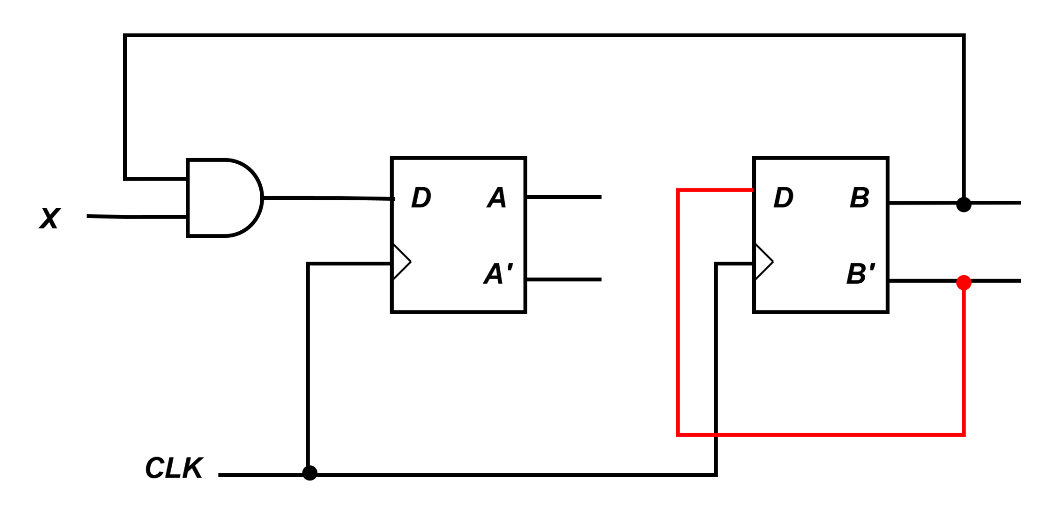
Practice Problem - 2
Draw the circuit diagram
(The number of present state will be equal to the number of flip-flops in the circuit)
‹#›
Department of Computer Science and Engineering
CSE260 - Digital Logic Design

Slide 44
Practice Problem - 3 (Self Study)
Implement the following counter using D FF:
Green—>Yellow—>Red—>Yellow—>Blue—>Red—>Yellow—>Green
Try it Yourself
Check how many external inputs you will need in this case.
‹#›
Department of Computer Science and Engineering
CSE260 - Digital Logic Design

